Slide 1
Building Capacity Across Instructional Environments by Shifting Mindsets:
Let’s Make a Plan?
Interactive Workbook
Marlene Cummings, MA, CCC-SLP
Marlene Cummings, M.A. CCC-SLP October 2023 Building Capacity Across Instructional Environments by Shifting Mindsets: Let’s Make a Plan?
(Do Not Use without presenter’s permission)

Slide 2
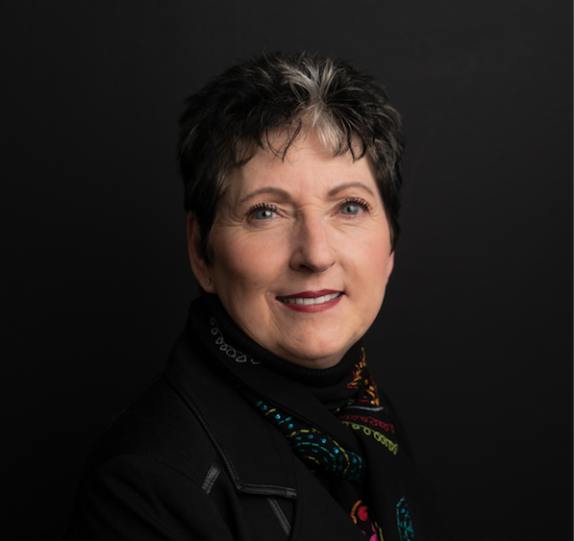
Hello!
Marlene Cummings, MA, CCC-SLP
Speech-Language Pathologist
AAC Consultant - MRC Communications
mkrcummings@icloud.com
Marlene Cummings, M.A. CCC-SLP February 13, 2024 The IMPACT of Shifting MIndsets to Building Capacity Across Instructional Environments
(Do Not Use without presenter’s permission)ion)

Slide 3
Learning Outline
Introduction and Overview
Mindset - Expert/Collaborative
Building Capacity & Components
Current State
Examples of Team Approaches & Outcomes
Summary and Action Plan
Marlene Cummings, M.A. CCC-SLP February 13, 2024 The IMPACT of Shifting MIndsets to Building Capacity Across Instructional Environments
(Do Not Use without presenter’s permission)n)

Slide 4
Mindset Matters
1
Shifting from an expert to a collaborative model
Marlene Cummings, M.A. CCC-SLP February 13, 2024 The IMPACT of Shifting MIndsets to Building Capacity Across Instructional Environments
(Do Not Use without presenter’s permission)

Slide 5
Mindset:
The established set of attitudes held by someone.
A collection of beliefs that shape your thought habits
“A mindset is strengthened and forged by thoughts and information which you believe to be true.”
Marlene Cummings, M.A. CCC-SLP February 13, 2024 The IMPACT of Shifting MIndsets to Building Capacity Across Instructional Environments
(Do Not Use without presenter’s permission)

Slide 6
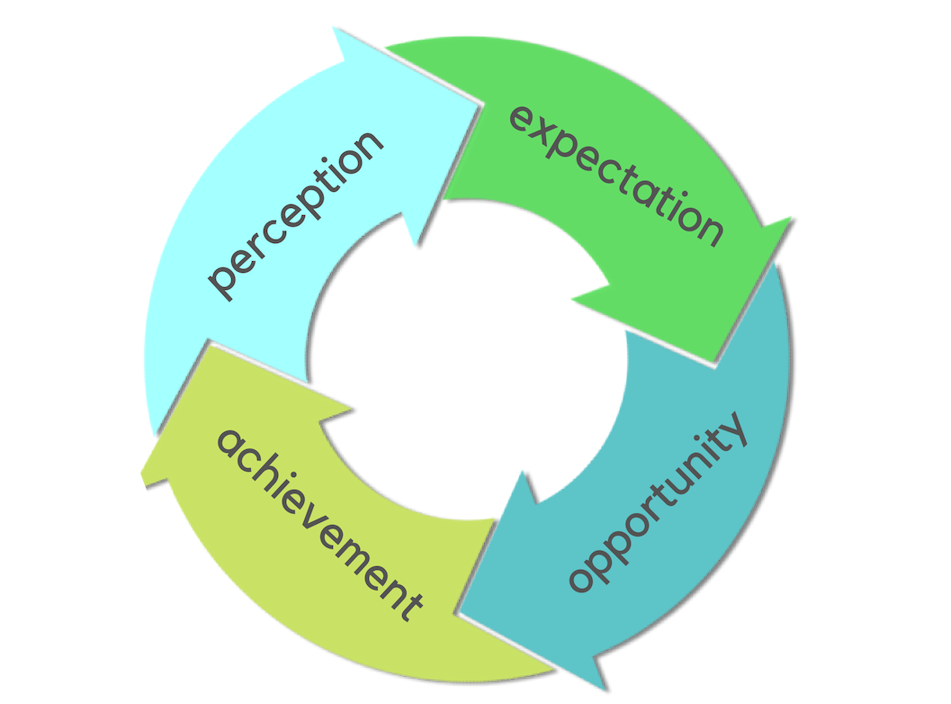
Process is from the work of Dr. Carole Zangari
Graphics by Rachael Langley
Marlene Cummings, M.A. CCC-SLP February 13, 2024 The IMPACT of Shifting MIndsets to Building Capacity Across Instructional Environments
(Do Not Use without presenter’s permission)n)
Notes:
Perception wheel

Slide 7
“Our beliefs become our thoughts,
Our thoughts become our feelings,
Our feelings become our actions,
Our actions are what others see.”
- Marlene Cummings
Marlene Cummings, M.A. CCC-SLP February 13, 2024 The IMPACT of Shifting MIndsets to Building Capacity Across Instructional Environments
(Do Not Use without presenter’s permission)

Slide 8
Perceptions and Beliefs
What was your takeaway regarding “Mindset - the impact of your perceptions and beliefs”?
Marlene Cummings, M.A. CCC-SLP February 13, 2024 The IMPACT of Shifting MIndsets to Building Capacity Across Instructional Environments
(Do Not Use without presenter’s permission)

Slide 9
Expert versus Collaborative Model
What does the “expert” look like in this model?
Capacity Building
Focus on strategic outcome
Partnership
Provides process and tools
Skills transfer to close current & future gaps
Transfer of knowledge
Expert Model
Focus on solution of current problem
Supplier of solution to current problem
Provide expertise to solve current problem
Skills transfer to solve current problem
Holds proprietary knowledge
Marlene Cummings, M.A. CCC-SLP February 13, 2024 The IMPACT of Shifting MIndsets to Building Capacity Across Instructional Environments
(Do Not Use without presenter’s permission)
Notes:
Teacher training literature seems to indicate that mastery of teaching skills be accomplished through the use of these 3 elements

Slide 10
Partnership - Let’s do this together
Leverage everyone’s skills – let the village be the village
(Who is everyone? Teachers, SLP’s, paraeducators, literacy
coaches, peers, families)
Embrace the power of group instruction - students learning from each other
Determine student specific needs & solutions through a capacity building lens - choose a solution that tackles several problems
Marlene Cummings, M.A. CCC-SLP February 13, 2024 The IMPACT of Shifting MIndsets to Building Capacity Across Instructional Environments
(Do Not Use without presenter’s permission)

Slide 11
Strength-Based Collaboration
Ask yourself or your team:
Are there aspects of the work only you can do?
What can you share - do together?
What can you support others in doing?
Instructional Strategies
Lesson planning
Progress monitoring
Goals
Assessment
Vocabulary Supports
Strategies for AAC users
Device updating and maintenance
Page set updating and modification
Others
Marlene Cummings, M.A. CCC-SLP February 13, 2024 The IMPACT of Shifting MIndsets to Building Capacity Across Instructional Environments
(Do Not Use without presenter’s permission)

Slide 12
Strength-Based Collaboration
What aspects of the work can only you do?
Marlene Cummings, M.A. CCC-SLP February 13, 2024 The IMPACT of Shifting MIndsets to Building Capacity Across Instructional Environments
(Do Not Use without presenter’s permission)

Slide 13
Strength-Based Collaboration
What aspects of the work can you share and/or do together?
Marlene Cummings, M.A. CCC-SLP February 13, 2024 The IMPACT of Shifting MIndsets to Building Capacity Across Instructional Environments
(Do Not Use without presenter’s permission)

Slide 14
Strength-Based Collaboration
What can you support others in doing?
Marlene Cummings, M.A. CCC-SLP February 13, 2024 The IMPACT of Shifting MIndsets to Building Capacity Across Instructional Environments
(Do Not Use without presenter’s permission)

Slide 15
How Influence Drives Change
Marlene Cummings, M.A. CCC-SLP February 13, 2024 The IMPACT of Shifting MIndsets to Building Capacity Across Instructional Environments
(Do Not Use without presenter’s permission)

Slide 16
Your Sphere of Influence
Things to Consider
What do I know?
Who can I influence?
What do I need
to learn?
How can I make
the biggest impact?
Marlene Cummings, M.A. CCC-SLP February 13, 2024 The IMPACT of Shifting MIndsets to Building Capacity Across Instructional Environments
(Do Not Use without presenter’s permission)
Notes:
I want you to consider the idea of a collaborative model versus our typical “expert” model of service deliver in literacy . - while understanding that we will always need our experts,literacy is part of everyday life - that means everyone needs to be considered as someone who can be influenced and who can influence. When I present I will often have people in the audience who know more than I do and could be presenting the content much better than me.They might be sitting there saying ”I already know this” or “I am already doing this”. My charge to them is to think about who they are influencing - whose mind are they changing - who are they targeting to share their story with?

Slide 17
How Influence Drives Change
How are you influenced?
Marlene Cummings, M.A. CCC-SLP February 13, 2024 The IMPACT of Shifting MIndsets to Building Capacity Across Instructional Environments
(Do Not Use without presenter’s permission)

Slide 18
How Influence Drives Change
How do you influence others?
Marlene Cummings, M.A. CCC-SLP February 13, 2024 The IMPACT of Shifting MIndsets to Building Capacity Across Instructional Environments
(Do Not Use without presenter’s permission)

Slide 19
Building Capacity & Its Components
2
What to consider and where to start
Marlene Cummings, M.A. CCC-SLP February 13, 2024 The IMPACT of Shifting MIndsets to Building Capacity Across Instructional Environments
(Do Not Use without presenter’s permission)

Slide 20
Key Features of Building Capacity
“Why should we consider embracing a collaborative model, which puts less emphasis on only being an expert?”
Marlene Cummings, M.A. CCC-SLP February 13, 2024 The IMPACT of Shifting MIndsets to Building Capacity Across Instructional Environments
(Do Not Use without presenter’s permission)
Notes:
Marlene
drivers that move us toward change
lack of direction - unclear outcomes
progress to outcomes is stalled or blurry
unfulfilled partnerships - do we even consider who we could be partnering with?

Slide 21
Building Capacity
Why are you here today?
Marlene Cummings, M.A. CCC-SLP February 13, 2024 The IMPACT of Shifting MIndsets to Building Capacity Across Instructional Environments
(Do Not Use without presenter’s permission)

Slide 22
The Process
“Capacity Building is a process for
developing & strengthening the:
skills, instincts, abilities,
processes, and resources
that organizations need to survive, adapt & thrive in the fast-changing world”
Marlene Cummings, M.A. CCC-SLP February 13, 2024 The IMPACT of Shifting MIndsets to Building Capacity Across Instructional Environments
(Do Not Use without presenter’s permission)

Slide 23
The Process: Skills, Instincts, Abilities
What do you consider when thinking about skills, instincts and abilities?
Marlene Cummings, M.A. CCC-SLP February 13, 2024 The IMPACT of Shifting MIndsets to Building Capacity Across Instructional Environments
(Do Not Use without presenter’s permission)

Slide 24
The Process: Processes
What do you think of when you consider processes?
Marlene Cummings, M.A. CCC-SLP February 13, 2024 The IMPACT of Shifting MIndsets to Building Capacity Across Instructional Environments
(Do Not Use without presenter’s permission)

Slide 25
The Process: Resources
What do you think of when you consider resources?
Marlene Cummings, M.A. CCC-SLP February 13, 2024 The IMPACT of Shifting MIndsets to Building Capacity Across Instructional Environments
(Do Not Use without presenter’s permission)

Slide 26
Keys
The keys to a capacity building approach:
Develop a common
(shared) knowledge
Focus on a few goals
Sustain an intense effort
over multiple years
Coherence: The Right Drivers in Action for Schools, Districts and Systems
(Fullan and Quinn, 2016)
Marlene Cummings, M.A. CCC-SLP February 13, 2024 The IMPACT of Shifting MIndsets to Building Capacity Across Instructional Environments
(Do Not Use without presenter’s permission)

Slide 27
The Keys-
What do you think of when you consider: “develop a common or shared knowledge?
Marlene Cummings, M.A. CCC-SLP February 13, 2024 The IMPACT of Shifting MIndsets to Building Capacity Across Instructional Environments
(Do Not Use without presenter’s permission)

Slide 28
The Keys-
Do you currently have goals/outcomes? Do they need to be revisited?
Marlene Cummings, M.A. CCC-SLP February 13, 2024 The IMPACT of Shifting MIndsets to Building Capacity Across Instructional Environments
(Do Not Use without presenter’s permission))

Slide 29
The Keys-
How can you sustain an intense effort over time? Do you currently have a 3-5 year plan? How often do you revisit your plan?
Marlene Cummings, M.A. CCC-SLP October 2023 Building Capacity Across Instructional Environments by Shifting Mindsets: Let’s Make a Plan?
(Do Not Use without presenter’s permission)

Slide 30
The Learners
Professional learning/teacher training is accomplished
through:
Understanding the theory & research underlying each skill
The opportunity to observe multiple demonstrations
Practice and feedback either under simulated conditions or in the classroom
Marlene Cummings, M.A. CCC-SLP February 13, 2024 The IMPACT of Shifting MIndsets to Building Capacity Across Instructional Environments
(Do Not Use without presenter’s permission)

Slide 31
The Learners -
How can you and others understand the theory and research underlying each skill?
Marlene Cummings, M.A. CCC-SLP February 13, 2024 The IMPACT of Shifting MIndsets to Building Capacity Across Instructional Environments
(Do Not Use without presenter’s permission)

Slide 32
The Learners -
How can you create opportunities to observe multiple demonstrations of the skill?
Marlene Cummings, M.A. CCC-SLP February 13, 2024 The IMPACT of Shifting MIndsets to Building Capacity Across Instructional Environments
(Do Not Use without presenter’s permission)

Slide 33
The Learners -
How can you provide practice and feedback in the classroom?
Marlene Cummings, M.A. CCC-SLP February 13, 2024 The IMPACT of Shifting MIndsets to Building Capacity Across Instructional Environments
(Do Not Use without presenter’s permission)

Slide 34
Considerations:
Current organization practices
Yearly needs assessment surveys
Review of Professional Dev. Research
Current Implementation Science Info.
Job Embedded Professional Learning
Coaching and Mentoring models
Professional Learning Considerations
Priorities:
Leaning over time (not one shot)
Learning within a community
Onsite implementation support
Available on-demand resources
Replicable in varied settings by varied professionals with varied resources
Marlene Cummings, M.A. CCC-SLP October 2022 Building Capacity Across Instructional Environments by Shifting Mindsets: How Do We Do It?
(Do Not Use without presenter’s permission)

Slide 35
Professional Learning
Considerations and Priorities
Marlene Cummings, M.A. CCC-SLP February 13, 2024 The IMPACT of Shifting MIndsets to Building Capacity Across Instructional Environments
(Do Not Use without presenter’s permission)

Slide 36
Starting Point to Next Steps
3
A Shift in Thinking and Action
Marlene Cummings, M.A. CCC-SLP February 13, 2024 The IMPACT of Shifting MIndsets to Building Capacity Across Instructional Environments
(Do Not Use without presenter’s permission)ion)

Slide 37
The Outcome
As this approach is embraced by the “people,” you will see:
Increased motivation to learn & implement
Deepened & continual learning
Reflection resulting in ongoing change
Problem solving across the organization
Marlene Cummings, M.A. CCC-SLP February 13, 2024 The IMPACT of Shifting MIndsets to Building Capacity Across Instructional Environments
(Do Not Use without presenter’s permission)

Slide 38
The Outcome -
What does increased motivation to learn and implement look like?
Marlene Cummings, M.A. CCC-SLP February 13, 2024 The IMPACT of Shifting MIndsets to Building Capacity Across Instructional Environments
(Do Not Use without presenter’s permission)n)

Slide 39
The Outcome -
What does deepened and continual learning look like and how do you support it?
Marlene Cummings, M.A. CCC-SLP February 13, 2024 The IMPACT of Shifting MIndsets to Building Capacity Across Instructional Environments
(Do Not Use without presenter’s permission)

Slide 40
The Outcome -
What does reflection resulting in ongoing change look like?
Marlene Cummings, M.A. CCC-SLP February 13, 2024 The IMPACT of Shifting MIndsets to Building Capacity Across Instructional Environments
(Do Not Use without presenter’s permission)

Slide 41
The Outcome -
What does problem solving across the organization look like?
Marlene Cummings, M.A. CCC-SLP February 13, 2024 The IMPACT of Shifting MIndsets to Building Capacity Across Instructional Environments
(Do Not Use without presenter’s permission)

Slide 42
The Impact
The impact of capacity building on an organization:
Reinforces the implementation of strategies/skills
Accelerates the speed of change
Fosters sustainability
Develops a culture
Marlene Cummings, M.A. CCC-SLP February 13, 2024 The IMPACT of Shifting MIndsets to Building Capacity Across Instructional Environments
(Do Not Use without presenter’s permission)

Slide 43
The Impact -
How might you recognize impact in your organization?
Marlene Cummings, M.A. CCC-SLP February 13, 2024 The IMPACT of Shifting MIndsets to Building Capacity Across Instructional Environments
(Do Not Use without presenter’s permission)

Slide 44
Consider the Current State
What is working?
Just beginning to work
Will work if you tweak it a bit
Will work if you partner with a colleague
What is not working?
Is it curriculum, classroom, or student specific?
What are the challenges?
Consider the Conditions for Learning (Koppenhaver and Erickson)
What are the barriers?
Is it a policy, practice, attitude, skill, or knowledge barrier?
Marlene Cummings, M.A. CCC-SLP February 13, 2024 The IMPACT of Shifting MIndsets to Building Capacity Across Instructional Environments
(Do Not Use without presenter’s permission)

Slide 45
Opportunity barriers
The Participation Model, Beukelman & Mirenda, 2012
Staff attitudes
Policies
Staff knowledge
Practices
Staff skill
Marlene Cummings, M.A. CCC-SLP October 2022 Building Capacity Across Instructional Environments by Shifting Mindsets: How Do We Do It?
(Do Not Use without presenter’s permission)
Notes:
Marlene
We’ve defined the barriers above, so this slide focuses on the interplay between them. E.g. Building knowledge will improve skill. Changing policy can cause practice to change.

Slide 46
Opportunity Barriers
Policy
Access to AAC/Literacy is limited by policies or regulations.
Someone in authority has created this barrier.
Practice
Access to AAC/Literacy is limited by “the way we’ve always done it.” Practices may not reflect formal policies or knowledge.
Attitudinal
Access to AAC/Literacy is limited by negative or restrictive attitudes about the importance of AAC/literacy instruction or the potential for students to learn.
Knowledge
Access to AAC/Literacy is limited by the team’s lack of knowledge about effective instruction and implementation.
Skill
Access to AAC/Literacy is limited by the team’s difficulty with instruction and implementation, despite strong knowledge.
Marlene Cummings, M.A. CCC-SLP February 13, 2024 The IMPACT of Shifting MIndsets to Building Capacity Across Instructional Environments
(Do Not Use without presenter’s permission)

Slide 47
Current State Consideration
What is your current state? What is working and what is not working?
Marlene Cummings, M.A. CCC-SLP February 13, 2024 The IMPACT of Shifting MIndsets to Building Capacity Across Instructional Environments
(Do Not Use without presenter’s permission)

Slide 48
Current State
What are your current challenges and barriers
Marlene Cummings, M.A. CCC-SLP February 13, 2024 The IMPACT of Shifting MIndsets to Building Capacity Across Instructional Environments
(Do Not Use without presenter’s permission)

Slide 49
Steps to Consider
What are possible ways you address these barriers?
Marlene Cummings, M.A. CCC-SLP February 13, 2024 The IMPACT of Shifting MIndsets to Building Capacity Across Instructional Environments
(Do Not Use without presenter’s permission)

Slide 50
To Do:
Embrace a collaborative model recognizing the skills of the entire educational team
Strategically insert the expertise of the “expert” - clarify what can be done by others and when, why, and for what we need the “expert”
Ensure that instruction is a focus in the classroom for all students
Fill in the serious “shared knowledge” gap for teams
Determine and apply specific student supports with long-term solutions in mind
Marlene Cummings, M.A. CCC-SLP February 13, 2024 The IMPACT of Shifting MIndsets to Building Capacity Across Instructional Environments
(Do Not Use without presenter’s permission)

Slide 51
Process | Keys | Learners | Outcome | Impact
To develop & strengthen the: skills, instincts, abilities, processes, and resources | -Develop a common or shared knowledge -Focus on a few goals -Sustain an intense effort over multiple years | -Understand the theory & research underlying each skill -Opportunity to observe multiple demonstrations -Practice and feedback either under simulated conditions or in the classroom | -Increased motivation to learn & implement -Deepened & continual learning -Reflection resulting in ongoing change -Problem solving across organization | -Reinforces the implementation of strategies & skills -Accelerates the speed of change -Fosters sustainability -Develops a culture
Marlene Cummings, M.A. CCC-SLP February 13, 2024 The IMPACT of Shifting MIndsets to Building Capacity Across Instructional Environments
(Do Not Use without presenter’s permission)

Slide 52
Consider the Current State
What is working?
Just beginning to work
Will work if you tweak it a bit
Will work if you partner with a colleague
What is not working?
Is it curriculum, classroom, or student specific?
What are the challenges?
Consider the Conditions for Learning (Koppenhaver and Erickson)
What are the barriers?
Is it a policy, practice, attitude, skill, or knowledge barrier?
Marlene Cummings, M.A. CCC-SLP February 13, 2024 The IMPACT of Shifting MIndsets to Building Capacity Across Instructional Environments
(Do Not Use without presenter’s permission)

Slide 53
Thank you!
Questions? Email me -
Marlene Cummings, MA, CCC-SLP
mkrcummings@icloud.com
Marlene Cummings, M.A. CCC-SLP February 13, 2024 The IMPACT of Shifting MIndsets to Building Capacity Across Instructional Environments
(Do Not Use without presenter’s permission)

